Slide 1
UNIT II
TRAVEL AGENCY OPERATIONS
Topic:
Functions of travel agency

Slide 2
Functions of travel agency
Front office procedures
Dealing with customers: sales, advice, itinerary planning etc
Back office procedures
Not dealing directly with customers: administration

Slide 3
Front office procedures
Meeting and greeting customers
Advising clients on destinations, resorts, airlines and travel products
Planning itineraries
Making reservations
Calculating fares and charges
Producing tickets
Dealing with customer complaints

Slide 4
Back office procedures
Following-up bookings.
Making payments.
Banking.
Ordering stationery and currency.
Maintaining reservation records.
Ensuring brochures are racked and in stock.

Slide 5
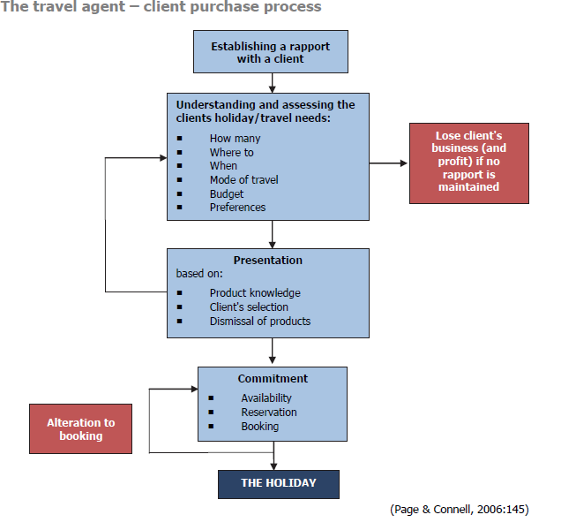

Slide 6
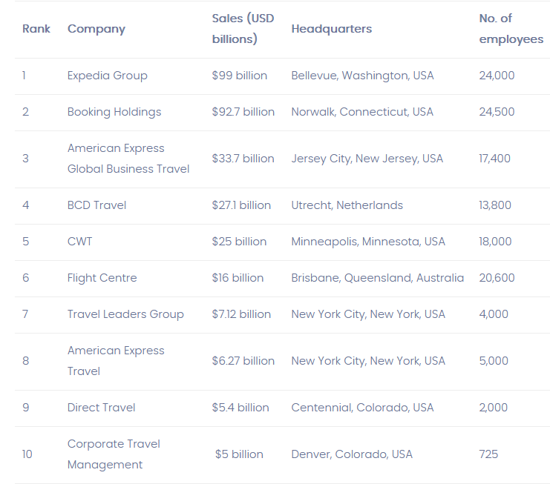

Slide 7
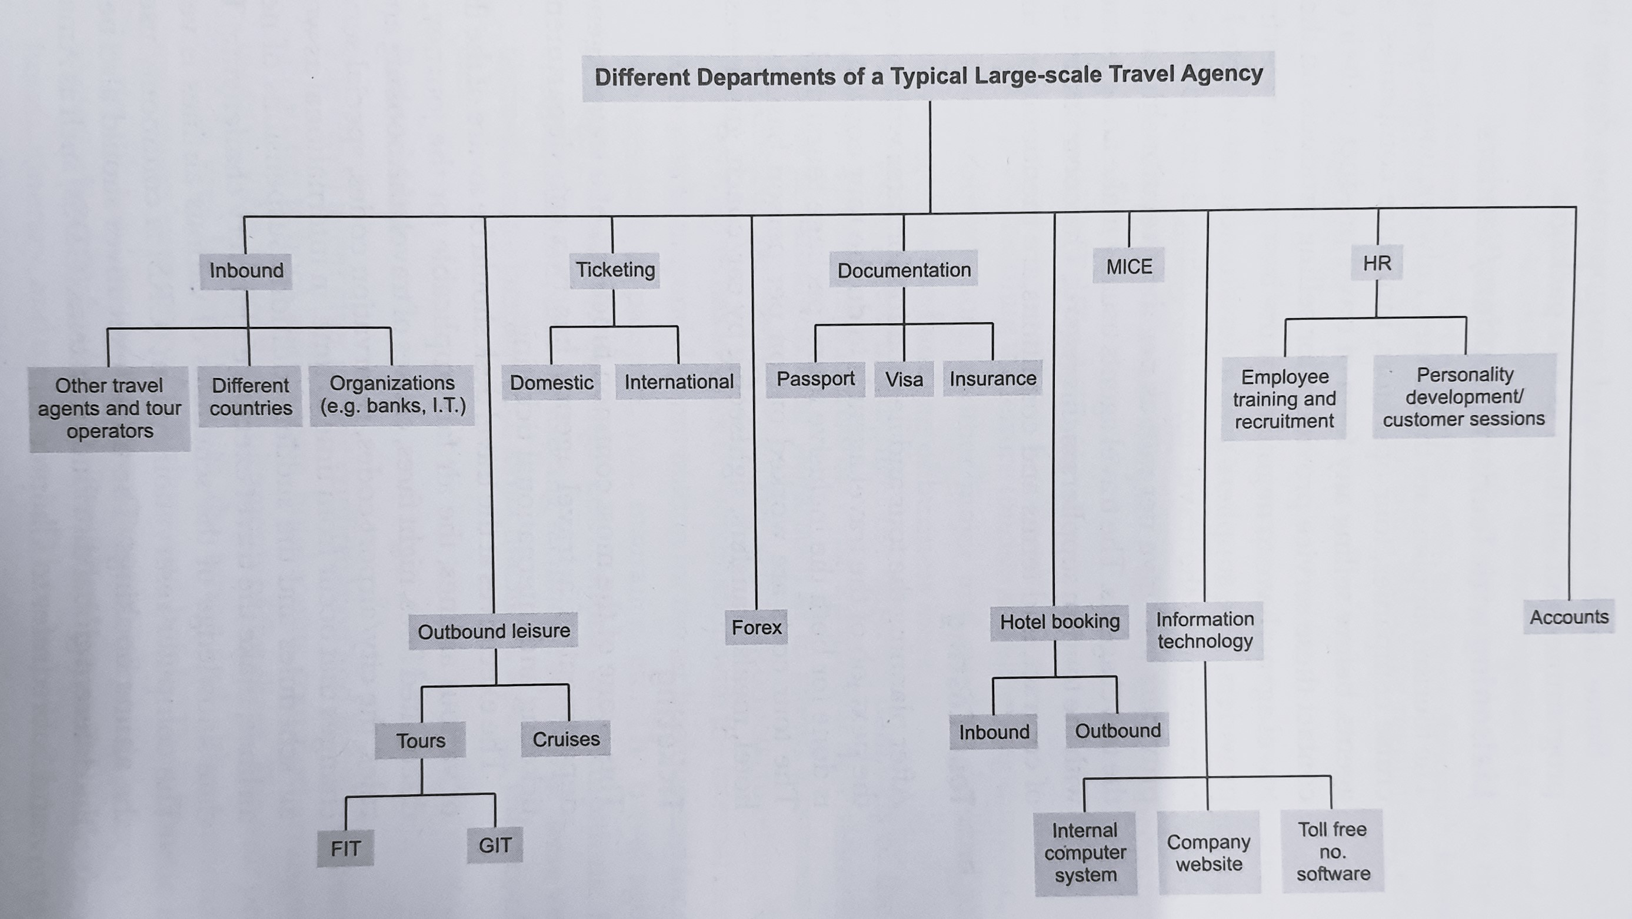
Departments of a large-scale travel agency

